Slide 1
The stack data structure is sequential collection of elements that follows the principle of list in first out(LIFO)
The last element inserted into the stack is the first element to be removed.
A stack of plated the last plate placed on the top of the stack is also the first plate to be removed from the stack.
Stack is an abstract data type. It is defined by its behavior rather than being a mathematical model.
The stack data structure supports two main operations
Push, which adds an element to the collection
Pop, which removed the most recently added element from the collection.
Stacks usage –
Browser history tracking
Undo operation when typing
Expression conversion
Call stack in javascritp runtime

Slide 2
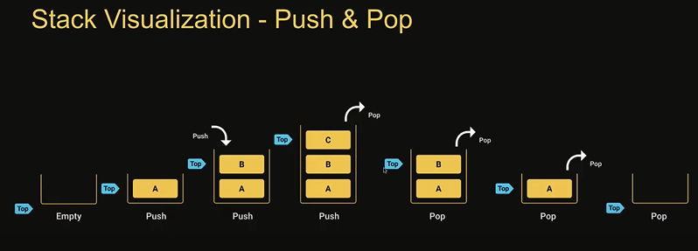
Stack Implementation
Push(element) =- add an element to the top of the stack
Pop() – remove the top element from the stack
Peek()- get the value of the top element without removing it
isEmpty() - check if the stack is empty
Size() – get the number of elements in the stack
Print() – visualize the elements in the stack

